Slide 1
IN THE NAME OF LORD
HEMODYNAMIC MONITORING

Slide 2
SHAHRAM KHAMISSI
MSCN
Ahvaz Jundishapour University of Medical sciences
Ayatollah Taleghani Hospital
Ahvaz – Iran
Autumn 1400

Slide 3
Clinical examination
General assessment :
Mental state
Hydration state
Hemodynamic state
Clinical evidence of warning signs :
Bleeding Manifestations
Abdominal Tenderness
Liver enlargement
Fluid accumulation : pleural effusion / ascites

Slide 4
Other important signs
Rash
Tachypnea – Acidotic breathing : that is indicates For shock
Tourniquet test : if negative or there is no bleeding manifestation

Slide 5
Hemodynamics?
Hemo: blood
Dynamics: movement
Hemodynamics: movement of blood
The measurement of the force (pressure) exerted by the blood as it moves through blood vessels or heart chambers during systole and diastole
For many critically ill patients, hemodynamic monitoring can add valuable information to the clinical management of the patient.
Notes:
For many critically ill patients, hemodynamic monitoring can add valuable information to the clinical management of the patient.

Slide 11
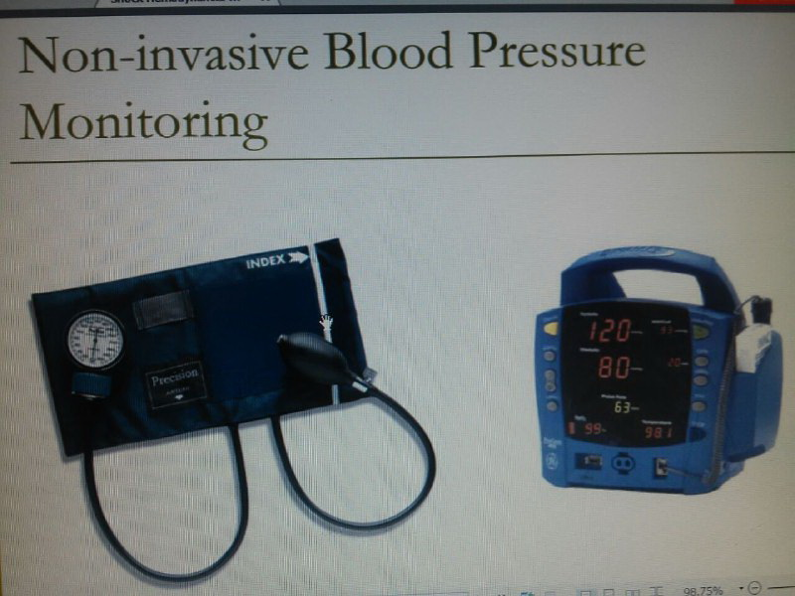

Slide 13
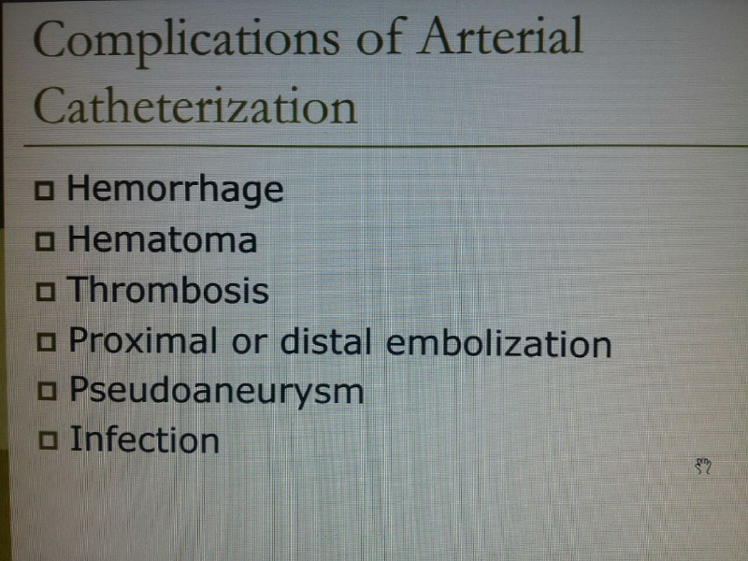

Slide 16
Physiology of Blood Pressure
Without sufficient BP the tissues will not receive oxygen.
High BP strains the heart and vessels.
3 factors control BP
Heart
Blood
Vessels
Notes:
Heart is the pump that creates blood pressure
Increase in heart rate/strength increases blood pressure
Decrease in heart rate/strength decreases blood pressure
Blood – amt of fluid
Vessels – vasoconstriction or vasodilation

Slide 17
Review of Heart Anatomy
4 chambers serving 4 circulatory branches
Each Chamber has its own BP.
Hemodynamics is measuring each of those pressures.
LV - Systemic arteries
RA – Systemic veins
RV – Pulmonary Arteries
LA – Pulmonary Veins

Slide 18
Cardiac Cycle
Refers to the pumping cycle consisting of systole and diastole.
Preload – stretch of ventricle muscle fibers before contraction, created by end-diastolic volume
Afterload – Resistance to ejection of blood during systole.

Slide 19
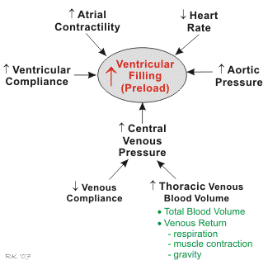

Slide 20
Types of Catheters
Arterial Catheter
Central Venous Catheter
Pulmonary Artery Catheter

Slide 21
Arterial Catheter
Common Uses
Measure systemic Artery Pressure
Collect arterial blood gas samples
Indocyanine green C.O. measurement
Insertion Sites
Radial, brachial, femoral, dorsalis pedis, umbilical (neonates)
Location
Within systemic artery near insertion site
Radial artery is the site of choice because of the collateral circulation to the hand provided by the ulnar artery
Notes:
Radial artery is the site of choice because of the collateral circulation to the hand provided by the ulnar artery

Slide 22
Arterial Catheter: Normal Arterial Pressure
120/80 mmHg
Systolic (contraction): 100-140 mmHg; min acceptable 90
Diastolic (relaxation): 60-90 mmHg
Mean: 80-100 mmHg
MAP = (systolic + 2 x diastolic)
3
The diastolic value receives greater weight in this formula because the diastolic phase is about twice as long as the systolic phase
A MAP of 60 mmHg is considered the minimum pressure needed to maintain adequate tissue perfusion
Notes:
The diastolic value receives greater weight in this formula because the diastolic phase is about twice as long as the systolic phase
A MAP of 60 mmHg is considered the minimum pressure needed to maintain adequate tissue perfusion

Slide 23
Arterial Catheter: Decreased Arterial Pressure
Absolute hypovolemia
Blood loss
Dehydration
Relative hypovolemia
Shock
Vasodilation
Cardiac Failure

Slide 26
Arterial Catheter: Increased Arterial Pressure
Improvement in circulatory volume and function
Sympathetic stimulation
Vasoconstriction
Administration of vasopressors

Slide 27
Arterial Catheter : Pulse Pressure
The difference between arterial systolic and diastolic pressure.
Pulse pressure = systolic pressure – diastolic pressure.
Bradycardia: low rate allows the blood volume more time for diastolic runoff and causes a lower diastolic pressure
Tachycardia: high rate allows the blood volume less time for diastolic runoff and causes a higher diastolic pressure
Notes:
Bradycardia: low rate allows the blood volume more time for diastolic runoff and causes a lower diastolic pressure
Tachycardia: high rate allows the blood volume less time for diastolic runoff and causes a higher diastolic pressure

Slide 28
Decrease Pulse Pressure
- ↓ pulse pressure = early sign of hypovolemia
↓ stroke volume (hypovolemia)
↑blood vessel compliance (shock)
Tachycardia

Slide 29
Increase Pulse Pressure
↑ pulse pressure = early sign of vol. restoration
↑ stroke volume (hypervolemia)
↓ blood vessel compliance (arteriosclerosis)
bradycardia

Slide 30
Cardiac Output
QT or CO = the amount of blood pumped out the left ventricle and into the systemic circulation.
CO = HR x SV
CO = (130 x BSA) / (CaO2 – CvO2)
Normal is 4 – 8 lpm and depends on body size.
Measured by thermal dilution technique.

Slide 31
Factors Affecting Cardiac Output
Factors affecting cardiac output in a healthy but untrained individual could be:
Increase/ decreased in heart rate
Change of posture
Sympathetic nervous system activity
Parasympathetic nervous system activity can also affect cardiac output.
Heart rate can vary by a factor of approximately 3, between 60 and 180 beats per minute, whilst stroke volume can vary between 70 and 120 ml, a factor of only 1.5.

Slide 32
Cardiac Index (CI)
Used to normalize CO measurements among patients of varying body size.
CI = CO/BSA - 2.5 – 3.5 L/min/m².
CI values between 1.8 and 2.5 L/min/m² indicate hypoperfusion.
CI < 1.8 L/min/m² may be indicative of cardiogenic shock.

Slide 33
Stroke Volume (SV)
Measures the average CO per one heartbeat.
↑ by drugs that raise cardiac contractility and during early stages of compensated septic shock.
↓ by drugs that lower cardiac contractility and during late stages of decompensated shock.
SV = CO / HR
NV: 40 to 80 mL

Slide 34
Stroke Volume Index (SVI)
Used to normalize stroke volume measurements among patients of varying body size.
SVI = SV / BSA
NV: 33 to 47 mL/m²

Slide 35
Factors ↑ SV, SVI, CO, CI
Positive Inotropic Drugs (↑ contractility)
Digoxin (Lanoxin), Dobutamine (Dobutrex), Epinephrine (Adrenalin), Dopamine (Intropin), Isoproterenol (Isuprel), Digitalis, Amrinone (Inocor)
Abnormal Conditions
Septic shock (early stages), Hyperthermia, Hypervolemia, ↓ vascular resistance

Slide 36
Factors ↓ SV, SVI, CO, CI
Negative Inotropic Drugs (↓ contractility)
Propanolol (Inderal), Metoprolol (Lopressor), Atenolol (Tenormin)
Abnormal Conditions
Septic shock (late stages), CHF, Hypovolemia, Pulmonary emboli, ↑ vascular resistance, MI
Hyperinflation of the Lungs
MV, CPAP, PEEP

Slide 37
Ejection Fraction
The ejection fraction is a measurement of the heart's efficiency and can be used to estimate the function of the left ventricle . The left ventricle pumps only a fraction of the blood it contains . A normal ejection fraction is more than 55% of the blood volume. If the heart becomes enlarged, even if the amount of blood being pumped by the left ventricle remains the same, the relative fraction of blood being ejected decreases. For example:
A healthy heart with a total blood volume of 100 mL that pumps 60 mL to the aorta has an ejection fraction of 60%.
A heart with an enlarged left ventricle that has a total blood volume of 140 mL and pumps the same amount (60 mL) to the aorta has an ejection fraction of 43%.
A reduced ejection fraction indicates that cardiomyopathy is present.

Slide 38
Central Venous Catheter: Central Venous Pressure (CVP)
CVP is pressure of the blood in the
Vena cava
Right atrium
Right ventricle
CVP is also referred to as
Right atrial pressure (RAP)
right side preload
Right ventricular end-diastolic pressure (RVEDP)
Notes:
where blood is returned to the heart from the venous system
Because the tricuspid valve is opened between the right atrium and ventricle during diastole (ventricular filling), CVP also represents right ventricular end-diastolic pressure (RVEDP) and reflects the preload for the right ventricle

Slide 39
Central Venous Catheter: Central Venous Pressure (CVP)
CVP measures right heart function and fluid levels
Transducer is placed at level of RA
Normal
2-6 mmHg by transducer
4-12 cmH₂0 by water manometer
Notes:
Ability of the right heart to move blood through the lungs and the left heart

Slide 40
Central Venous Catheter: Indications
Assessment of right ventricular function and intravascular volume status
Administration of fluids, parenteral nutrition, blood, or drugs
Emergency route for temporary pacemaker insertion

Slide 41
Central Venous Catheter
Common Uses
Measure central venous pressure
Administer fluid, blood, or medications
Aspiration of blood samples
Insertion Sites
Subclavian or internal jugular vein
Location
Superior vena cava near right atrium or within right atrium
Notes:
Sites: also antecubital veins, and rarely the femoral vein

Slide 42
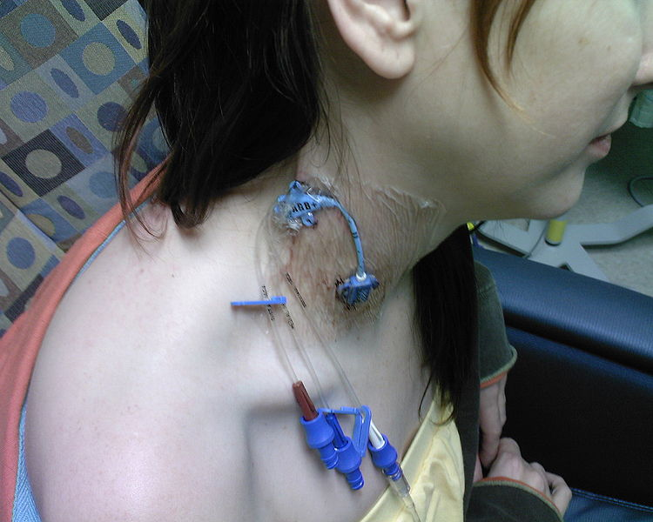
Central Venous Catheter: Decrease in CVP
Decreased venous return (VOLUME!)
Absolute hypovolemia
Blood loss - Hemorrhage
Dehydration
Relative hypovolemia
Shock
Vasodilation
Notes:
In general, any peripheral factor that decreases the amount of blood returning to the heart (venous return) decreases CVP

Slide 43
Decrease in CVP
Decreased intrathoracic pressure
Spontaneous inspiration
Increased ability of the right heart to move blood

Slide 44
Central Venous Catheter: Increase in CVP
Increased venous return
Hypervolemia
Volume overload
Fluids being given faster than the heart can tolerate
Increased intrathoracic pressure
Positive pressure ventilation
Pneumothorax
Notes:
increased venous return
volume overload or fluids being given more rapidly than the heart van tolerate
increased intrathoracic pressure
PPV (there is no reliable means of calculating the true CVP in patients receiving PPV)
pneumothorax

Slide 45
Central Venous Catheter: Increase in CVP
Decreased ability of the right heart to move blood
Right ventricular failure
Myocardial infarction
Cardiomyopathy
Left ventricular failure (late change in CVP)
An increase in CVP leads to a decrease in blood return to the right heart
Notes:
What if we have a patient who is hypovolemic but has pulmonary hypertension with decreases right ventricular function?
The CVP reflects the elevated pressure from the loss of ventricular function and does not fall to levels that would be expected with hypovolemia

Slide 46
Pulmonary Artery Catheter
Swan-Ganz Catheter
Flow-directed, balloon tipped catheter
Notes:
Monitoring heart rate, blood pressure, and CVP often do not provide accurate or timely data for correct diagnosis and management of cardiopulmonary problems. Can monitor the right and left sides of the heart
The pulmonary artery catheter has a number of variations however it is
Typically 110 cm in length
With 3 lumens (interior channels)
The exterior of the catheter is marked off in 10 cm segments used to estimate catheter tip location upon insertion

Slide 48
Pulmonary Artery Catheter
Distal lumen lies in the pulmonary artery
Measure pulmonary artery pressures
Aspirate mixed venous samples
Inject medications
Continuous monitoring of SvO2
Notes:
At the tip of the catheter there is an opening (PA distal lumen)
Measure PA pressure
Aspirate mixed venous samples
Inject medications
Some PA catheters are capable of continuous monitoring of SvO2

Slide 49
Pulmonary Artery Catheter: Insertion
Pulmonary Artery
Normal Pressure: 20-30 mmHg
6-15
Right ventricle
Normal pressure: 20-30 mmHg
0-5
Notes:
The catheter proceeds to the right ventricle
And into the pulmonary artery

Slide 50
Atrial Pressure Monitoring
a – Atrial contraction
c – Closure of tricuspid valves
X descent – Passive atrial filling
v – Atrial diastole
Y descent – Atrial emptying

Slide 51
Pulmonary Artery Catheter: Insertion
“Wedge”
Normal Pressure: 4-12 mmHg
Location
Branch of pulmonary artery
Notes:
Where it will eventually wedge in a smaller branch of the pulmonary artery
The balloon is then deflated and the catheter stabilized in place
The balloon remains deflated and the PAP tracing remains on the monitor at all times
The balloon is inflated only when the pulmonary capillary wedge pressure is being taken

Slide 52
Pulmonary Artery Catheter: Complications
Infection
Bleeding
Pneumothorax
Pulmonary artery hemorrhage
Pulmonary infarction
Air embolism
Cardiac arrhythmias

Slide 53
Pulmonary Artery Pressure Decreases
Volume of blood ejected by the right ventricle decreases – (“afterload” of the RV)
Pulmonary vasculature relaxes or dilates

Slide 54
Pulmonary Artery Pressure Increases
Pulmonary blood flow increases
Pulmonary vascular resistance increases
Constriction – hypoxemia, acidosis, drugs, diseases that cause pulmonary hypertension
Obstruction – pulmonary embolus
Compression – disease constricting pulmonary vasculature
Notes:
Constriction: hypoxemia, acidosis, vasoactive drugs
Obstruction: emboli
Compression: pulmonary parenchymal disease compresses pulmonary vasculature

Slide 55
Pulmonary Capillary Wedge Pressure
Normal: 8 mm hg (4-12 range)
Monitors blood moving into the left heart.
Represents the pulmonary venous drainage back to the left heart.

Slide 56
PCWP
The PAP diastolic can be used to estimate PCWP is some situations
A comparison of PCWP and PAP can be used to differentiate between cardiac and non-cardiac pulmonary edema.
Increased PCWP and PAP = cardiac PE
Normal PCWP and Increased PAP = Non-cardiac PE

Slide 57
Pulmonary Capillary Wedge Pressure Decreases
Right heart failure
Cor pulmonale
Pulmonary embolism
Pulmonary hypertension
Air embolism
Hypovolemia
PCWP may be normal in the above pulmonary conditions.

Slide 58
Pulmonary Capillary Wedge Pressure Increases
left heart failure
mitral valve stenosis
CHF/ pulmonary edema
high PEEP effects
hypervolemia

Slide 59
Other Values to Know
Pulse Pressure – 40 mm HG
Stroke Volume – 60 – 130 ml/beat
EF – 65 – 75%
SVR - < 20 mmHg/L/min
PVR - < 2.5 mmHg/L/min

Slide 60
Shock
Inadequate tissue perfusion resulting in a hypoxic insult and causing widespread abnormal cell metabolism and membrane dysfunction.
Hypovolemic Shock
Cardiogenic Shock
Septic Shock
Neurogenic Shock
Anaphylactic Shock

Slide 62
Hypovolemic Shock
A decrease in the effective circulating blood volume
Hemorrhage: loss of whole blood
Non-hemorrhage: loss from the interstitial space
Dehydration
Vomiting, diarrhea, diuresis
Third space fluid shift
Burns, trauma, sepsis

Slide 63
Cardiogenic Shock
Systemic hypoperfusion due to profound heart failure and/or the ability to meet metabolic needs.
End stage of heart disease caused by
MI
Myocarditis
Cardiac tamponade
Severe valve dysfunction

Slide 64
Septic Shock
Shock associated with any infectious disease which causes relative hypovolemia.
Caused by many infectious agents
Predisposing factors
Invasive procedures
Organ damage
Immunocompromised

Slide 65
Neurogenic Shock
Dysfunction of the sympathetic nervous system resulting in massive peripheral vasodilation and systemic hypoperfusion.
Etiology
Brain or spinal cord trauma
Spinal anesthesia
Drugs

Slide 66
Anaphylactic Shock
Systemic reaction causing circulatory failure and biochemical abnormalities.
Etiology
Drugs
Blood products
Foods
Pollens
Venoms

Slide 69
Thank you for your Attention
Thank you for your Attention

